Slide 1

CSE- 102
Introduction to CS and
Programming Methodology Lab
Lab : 08 Expression, if-else
Fahad Ahmed
Lecturer, Dept. of CSE
E-mail: fahadahmed@uap-bd.edu

Slide 2
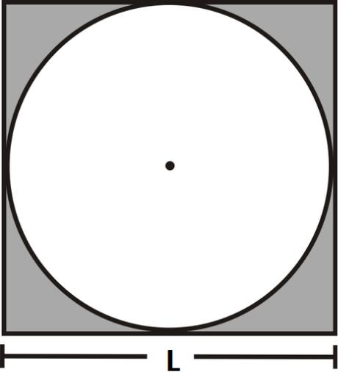
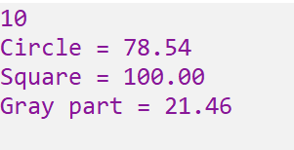
Problem-01: Class Performance
Write a program which will take L as input and print the area of circle, square and the gray part. Use Pi=3.1415
Input / Output

Slide 3
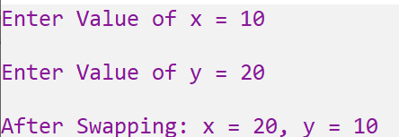
Problem-02
Write a program which will take two integer numbers as input and swap their values.
Input / Output

Slide 4
Problem-03
Write a program which will take two integer numbers as input and swap their values without third variable.
Input / Output

Slide 5
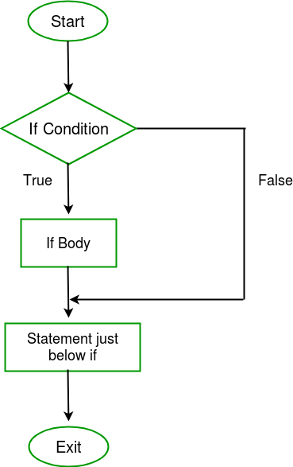
if-else
#include <stdio.h>
int main() {
int i = 1;
if (i ==1)
printf(“I is equal 1 ");
else
printf("i is not equal 1 ");
return 0;
}

Slide 6
Problem-04
Write a program which will take an integer number as input and print whether the number is Positive / Negative / Zero.
Input / Output
Input | Output
9 | Positive
0 | Zero
-5 | Negative

Slide 7
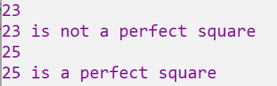
Problem-05
Write a program that will take an integer and determine whether the number is a perfect square or not.
Input / Output

Slide 8
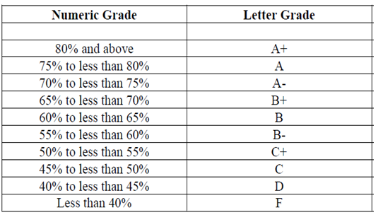
Problem-06
Take an integer number as input, consider it as an exam mark and print the corresponding Letter Grade.
Input / Output
Input | Output
85 | A+
39 | F
62 | B

Slide 9
Problem-07
Create a simple arithmetic calculator. The program will request the user to enter a number, an operator and another number. It should then carry out the specific arithmetic operation: addition, subtraction, multiplication or division of two numbers. Finally display the result.
Input / Output
Input | Output
3 + 3 | 6.00
2 – 2 | 0.00
2 * 4 | 8.00
33/2 | 16.50

Slide 10
Problem-08
A year that has 366 days is called a leap year.
A year is leap year if the following conditions are satisfied: Year is multiple of 400.Year is multiple of 4 and not multiple of 100.
Check whether a given year is a leap year or not.
Input / Output
Input | Output
2020 | 2020 is a leap year
2003 | 2003 is not a leap year

Slide 11
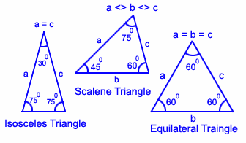
Problem-09
Write a C program to check whether a triangle is Equilateral, Isosceles or Scalene.
Input / Output
Input | Output
50 50 60 | Isosceles triangle
40 40 40 | Equilateral triangle

Slide 12
Problem-10
Write a C program to enter three sides of a triangle and check whether a triangle is valid or not.
Input / Output
Input | Output
10 20 20 | Valid Triangle
10 20 40 | Invalid Triangle

Slide 13

Thanks to All

